Slide 1

Search in COMP
COMP1011 Group 8
Yunfei LIU, Jiaming HAN, Longling GENG, Zhuchen WANG

Slide 2
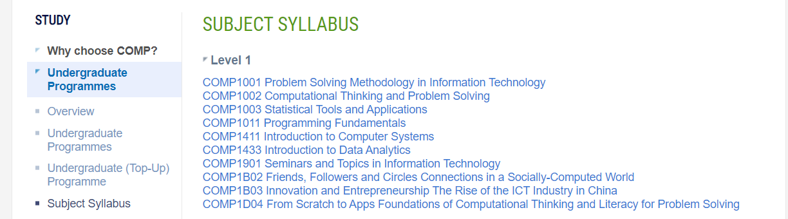
Introduction
A search engine to search information on COMP subjects

Slide 3
Introduction
Fulfill project requirements
Have more advanced features
Search in all content
User interaction for detail
Description form download

Slide 4
User Instructions
A user-friendly program.
1. Type keywords
2. View the result
3. Select and view details

Slide 5

Algorithm
Speed is the most important
We refer to the algorithm of Elastic Search
We improved the search method for our needs
We use “reverse index” for sorting.

Slide 6
Algorithm
Know subject code
Type subject code directly
Don’t know subject code
Type keywords and we will find for you

Slide 7
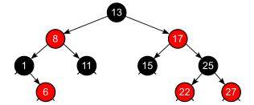
Algorithm
Use black-red tree to translate word to word ID

Slide 8
Algorithm
Search which subjects contain which IDs
Find how many times the word appeared
Calculate relative index
Display from the most related to the least

Slide 9
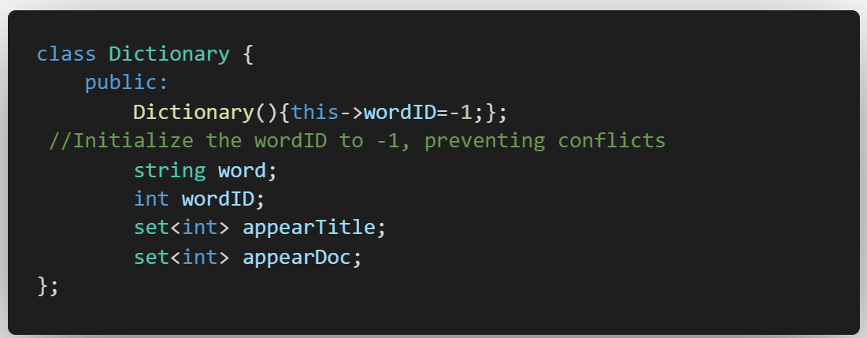
Data Structure
Two headers, contain two classes
Class Dictionary: contain word string, word ID, appeared document ID in title/content

Slide 10
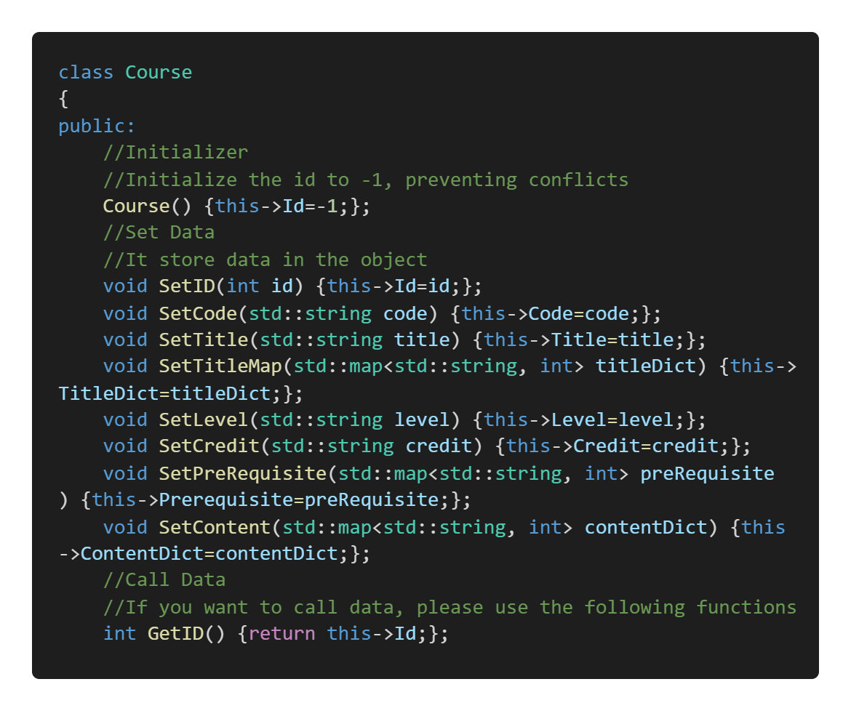
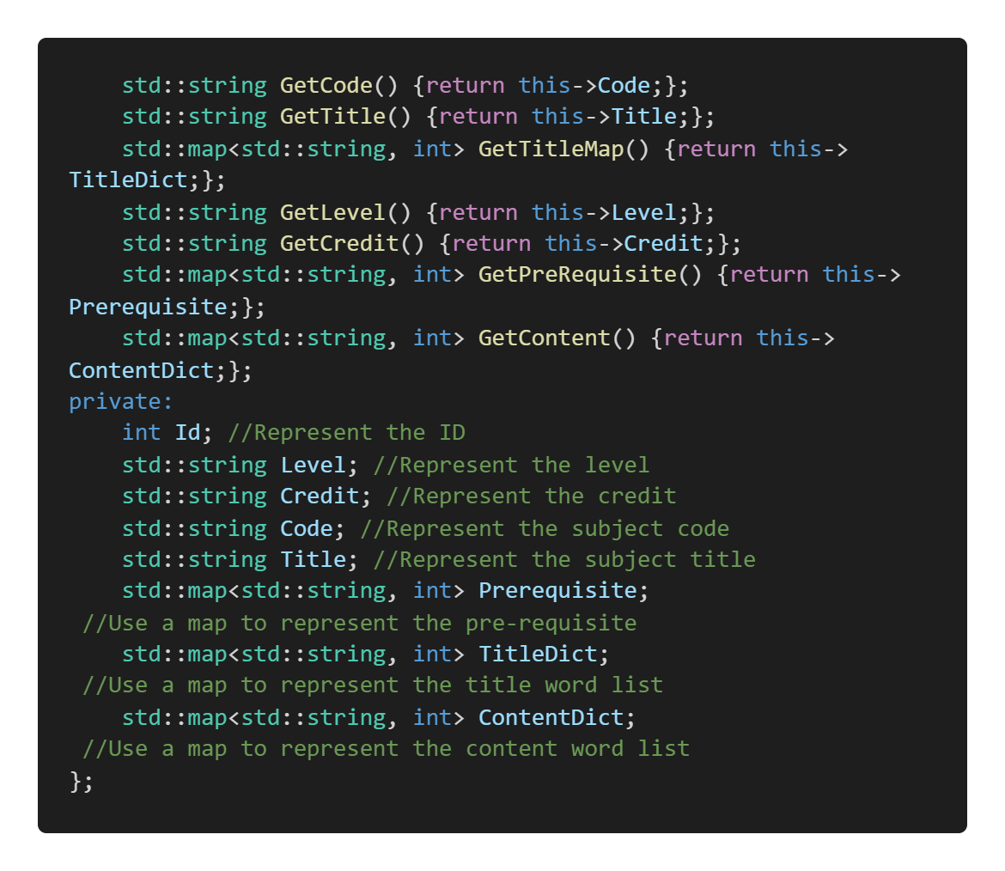
Data Structure
Class Course: contain course code, name, title, pre-requisite, credit, and word id appeared times

Slide 11
Implementation
Data Pre-process
Data Structure Design
User Input Process
Relative Index Calculation
Result Display

Slide 12



Implementation
We use Python to download and clean the data
C++ for main function process
Transform from PDF to TXT to JSON.
Python lib: pdfplumber
Python lib: json

Slide 13
Thank you
COMP1011 Group 8

